Slide 1
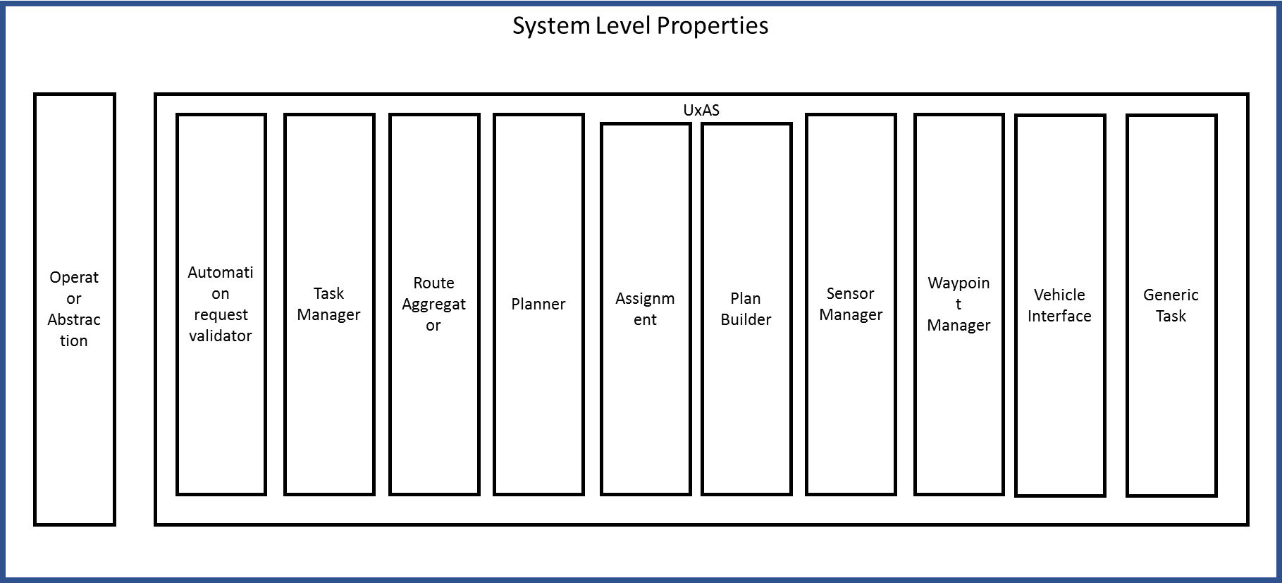
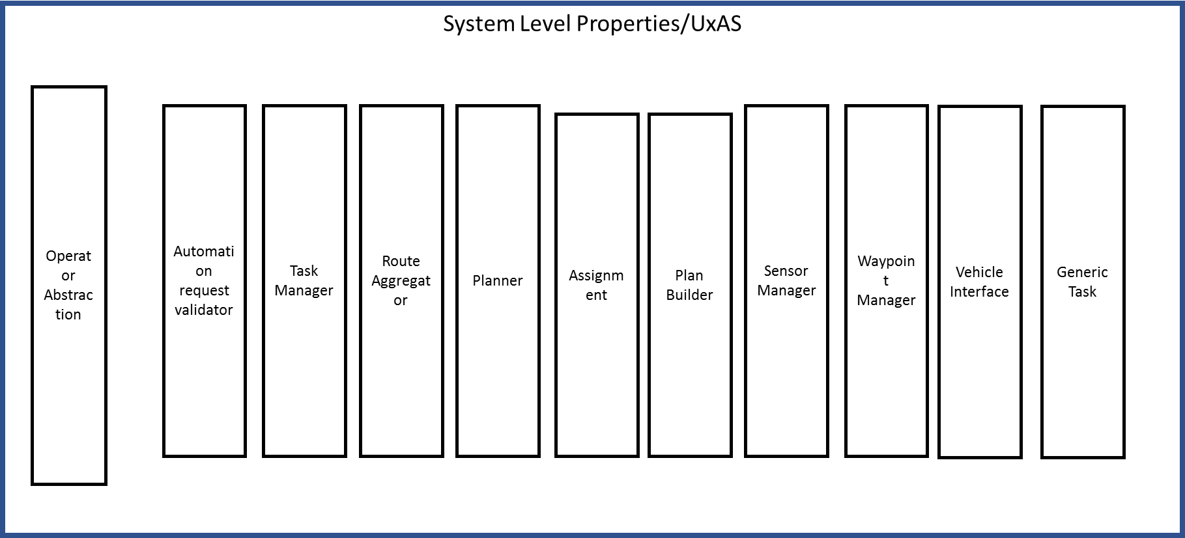
Architectural Modeling
All services modeled as separate systems with data types currently undefined.

Slide 2
system_level.aadl--connects operator abstraction to uxas
Operator_abtraction.aadl—operator package
Uxas_modlv2.aadl—connects base services and generic task
System Level Properties
Operator Abstraction
UxAS
Automation request validator
Task Manager
Route Aggregator
Planner
Assignment
Plan Builder
Sensor Manager
Waypoint Manager
Vehicle Interface
Generic Task

Slide 3
Uxas_model.aadl—connects all base services with operator abstraction and generic task
System Level Properties/UxAS
Operator Abstraction
Automation request validator
Task Manager
Route Aggregator
Planner
Assignment
Plan Builder
Sensor Manager
Waypoint Manager
Vehicle Interface
Generic Task

